Slide 1
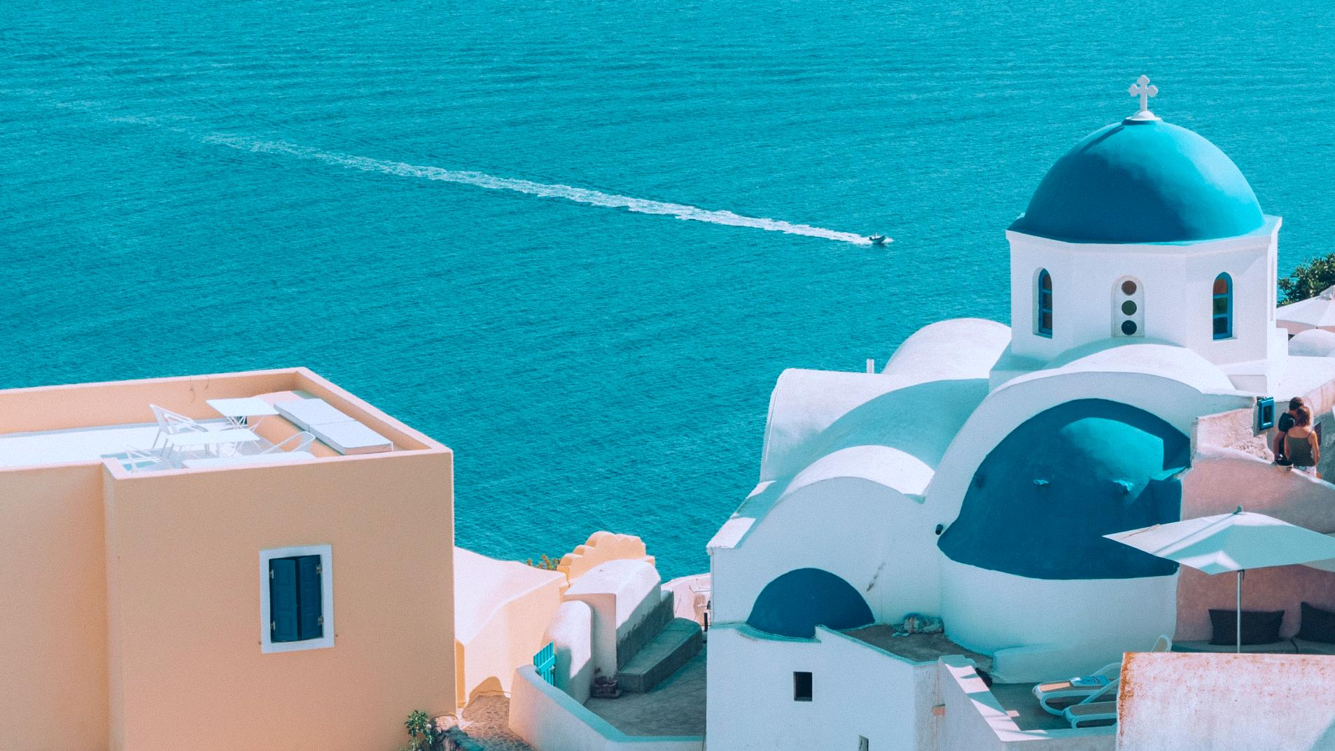
GREECE
14–22 JUL 2023

Slide 2
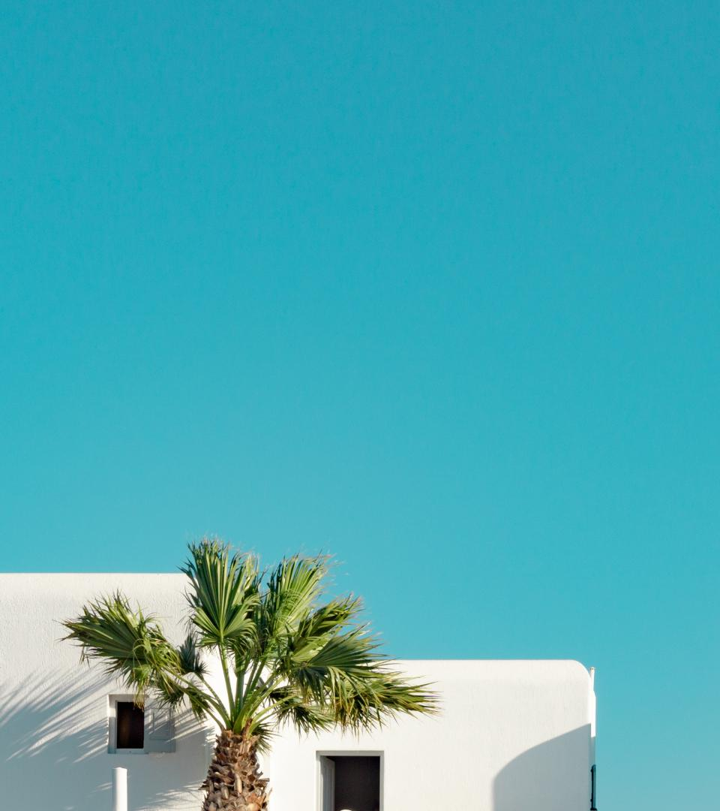
Day
6
Meteora
TRIP OVERVIEW
5
Delphi
FLIGHT DETAILS
1
Athens
14 JUL
12:25AM
1:20PM
HKG → DOH
DOH → ATH
3
Mykonos
22 JUL
7:40PM
8:35AM
ATH → DOH
DOH → HKG
2
Santorini
4
Crete

Slide 3
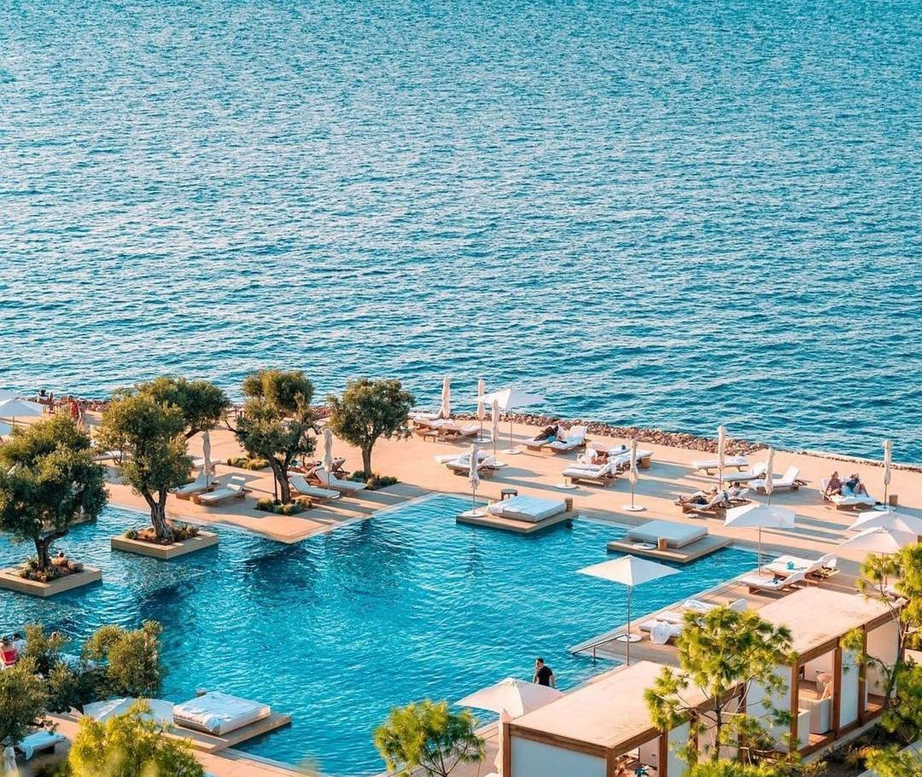
ACCOMODATION
ADDRESS
40 Apollonos Street, Vouliagmeni 16671, Greece
FOUR SEASONS ASTIR PALACE HOTEL ATHENS
SERVICES
Spa, gym, pool, yacht
NOTES
30 mins from ATH airport
30 mins from Acropolis and Parthenon

Slide 4
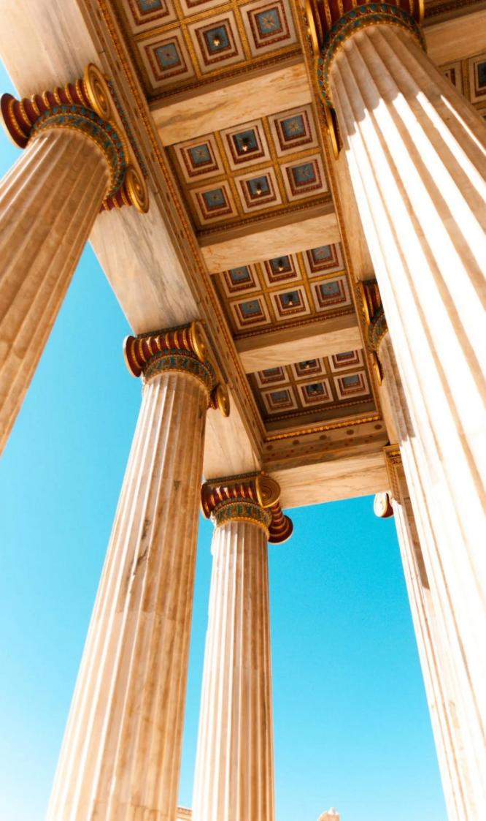
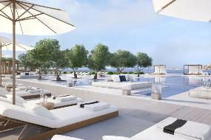
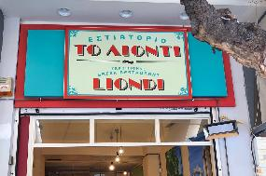
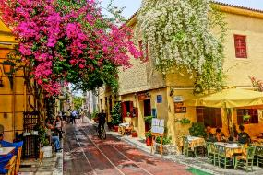
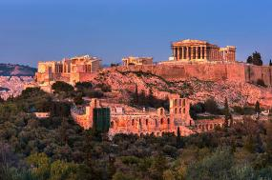
MORNING
8:00AM | Land in ATH airport, rent a car
11:00AM | Check in & relax at Four Seasons Astir Palace
AFTERNOON
1:00PM | Lunch at Liondi Traditional Greek Restaurant
2:00PM | Visit Acropolis Museum
4:00PM | Visit Parthenon, Erechtheion, Temple of Athena Nike
6:00PM | Stroll through Plaka district, Ancient Agora, Temple of Hephaestus
DAY 1
ATHENS
Athens, the capital city of Greece, is a must-visit destination for anyone interested in ancient history and architecture.
EVENING
8:30PM | Sunset from Philopappos Hill
9:00PM | Dinner at Spondi

Slide 5
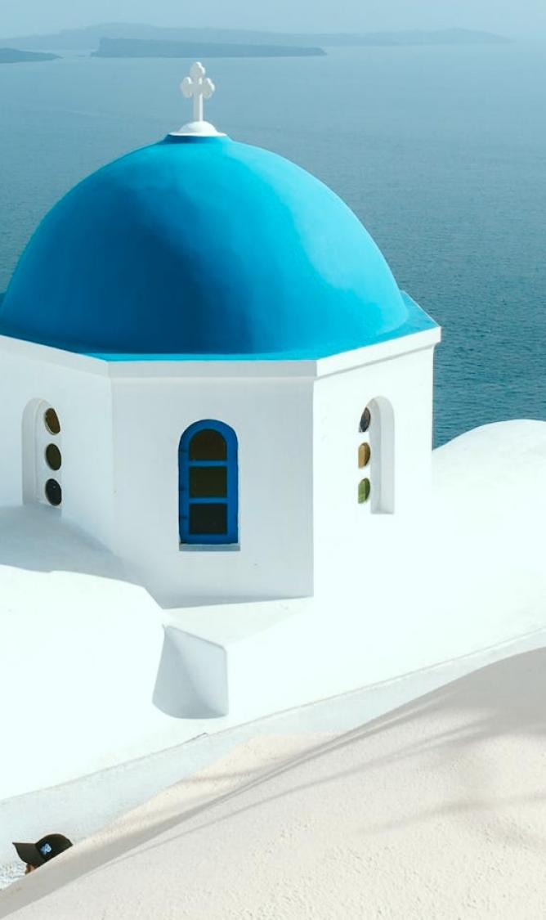
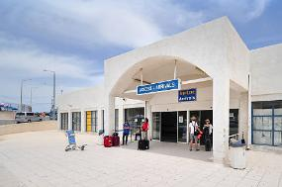
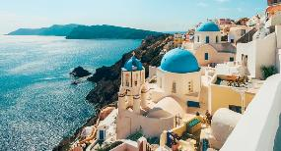
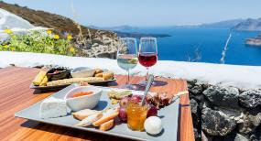
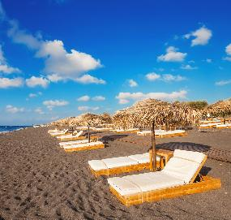
MORNING
9:00AM | Drive & check in at ATH airport
11:30AM | Fly to Santorini (Thira) International Airport
AFTERNOON
1:00PM | Lunch at Selene
2:30PM | Explore Oia Town
4:30PM | Visit Akrotiri Ruins
5:00PM | Visit winery
DAY 2
SANTORINI
Santorini is a charming Aegean island known for its caldera views, white-washed buildings, blue-domed churches, and narrow alleys.
EVENING
6:00PM | Relax at Red Beach and Black Beach
7:30PM | Rooftop dinner at Lauda
10:30PM | Fly back to Athens

Slide 6
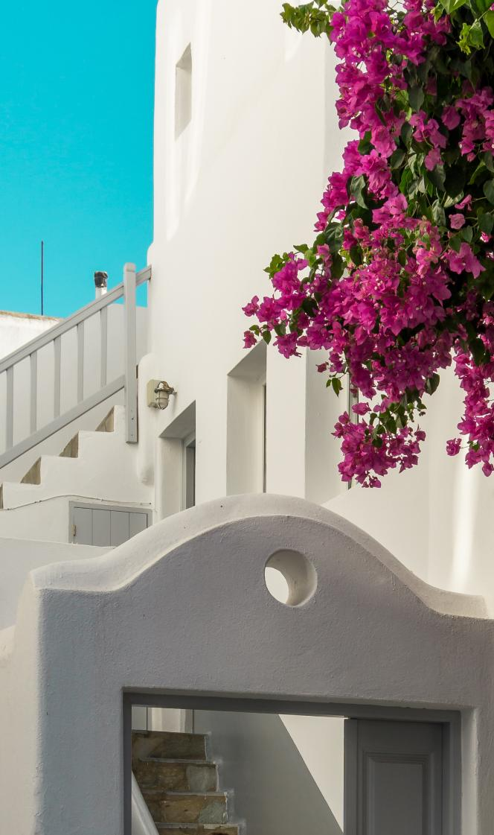
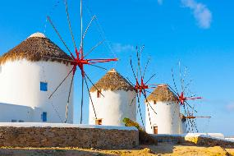
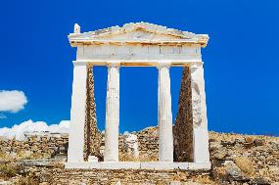
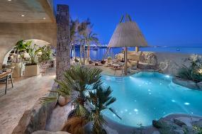
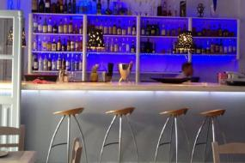
MORNING
9:00AM | Take ferry to Mykonos (~2.5 hours)
11:00AM | Check out Windmills
AFTERNOON
1:00PM | Lunch at Kiki’s Tavern
2:30PM | Go to nearby island, Delos
4:00PM | Explore ancient ruins, Temple of Apollo, Terrace of the lions
6:00PM | Relax at Psarou Beach Club
DAY 3
MYKONOS
Mykonos is famous for its lively parties, beautiful beaches, and vibrant nightlife with bars and clubs open until early morning.
EVENING
9:00PM | Fly back to Athens
10:00PM | Dinner at Funky Kitchen Club

